Slide 1
Vehicle Crash in New York City :
The details of Whens, Hows, and Wheres
-Tikam Rai

Slide 2
Data Collection
NYC Open data: https://data.cityofnewyork.us/Public-Safety/Motor-Vehicle-Collisions-Crashes/h9gi-nx95
Analyzed 400K> Vehicle crash records:Jan 2017-Dec 2019
Accidents with $1000 or more damage, injured, killed
When does it happen most
Most common reasons for crashes
Top places (streets) and time to avoid (if possible)
How to improve public safety

Slide 3
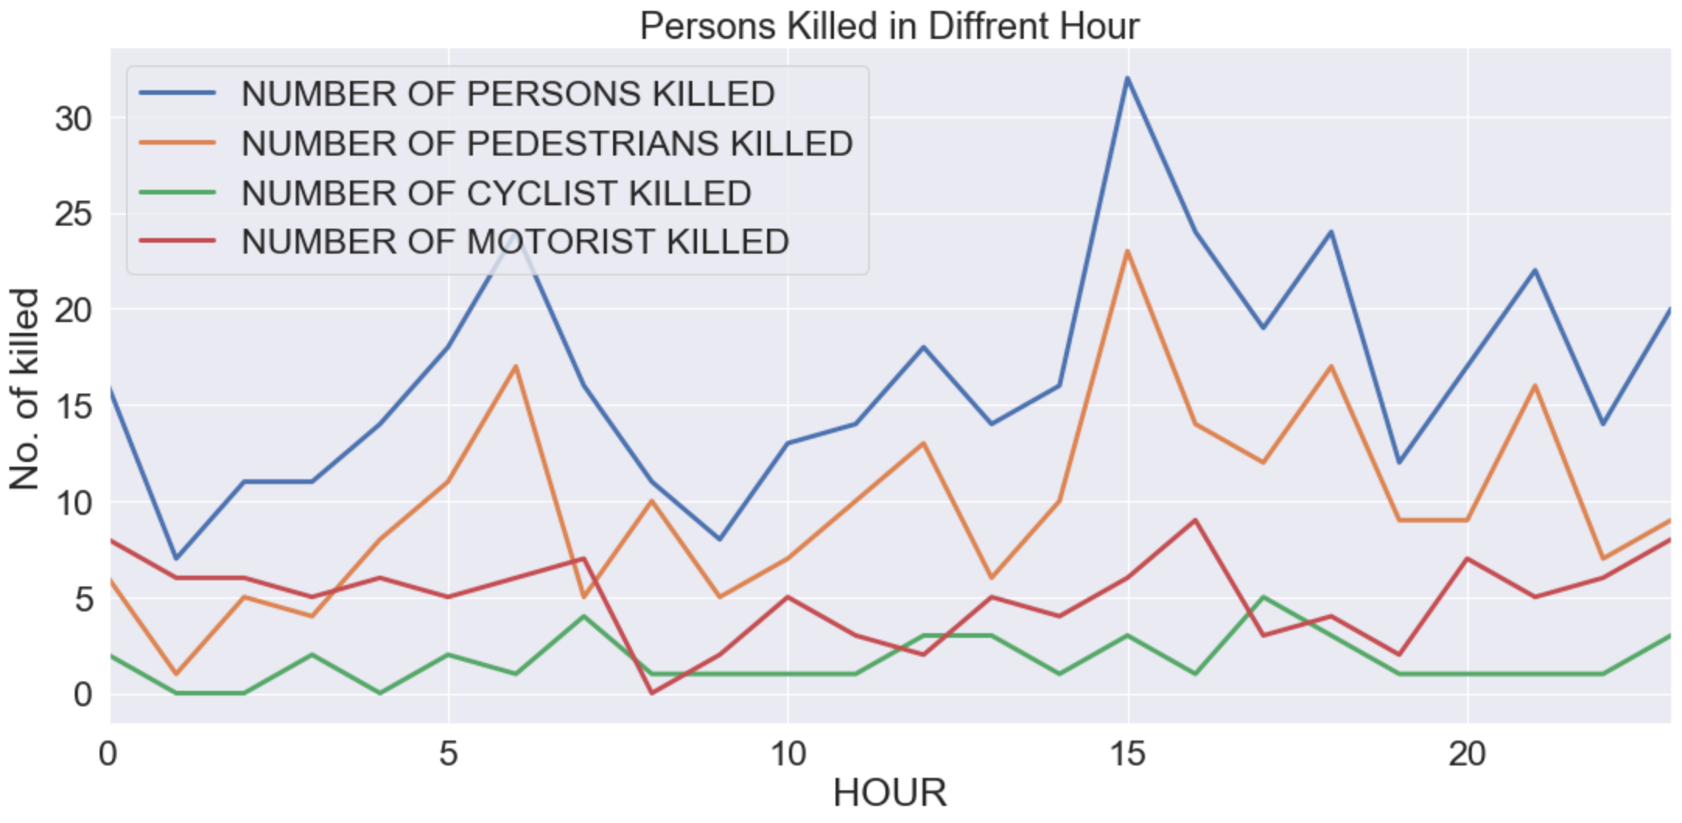
When? Death from auto accident each hour

Slide 4
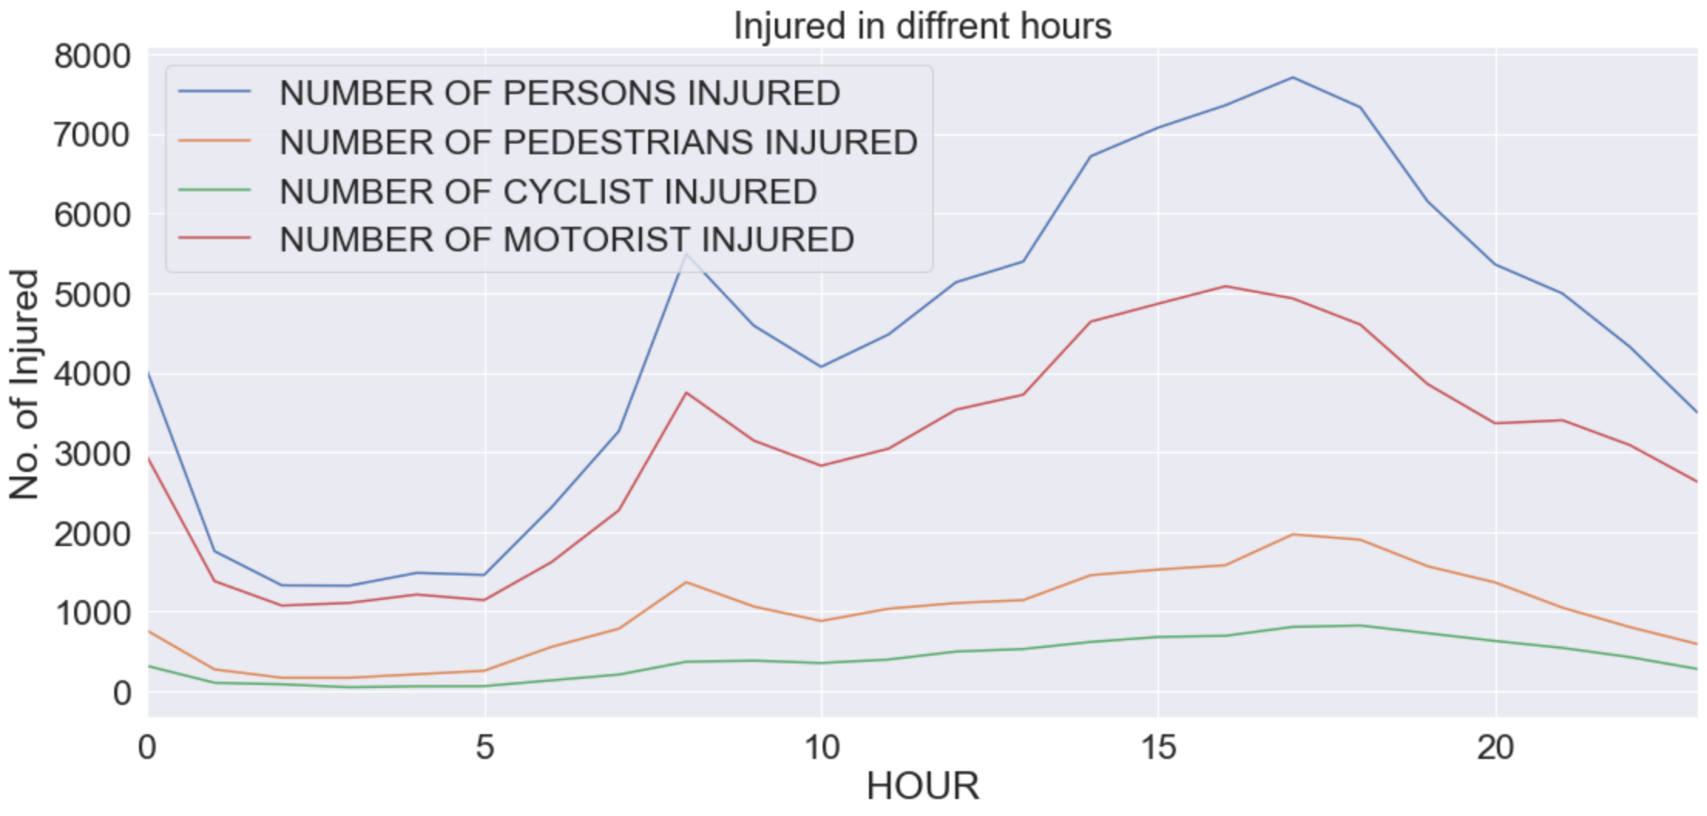
When? Injury from auto accident each hour

Slide 5
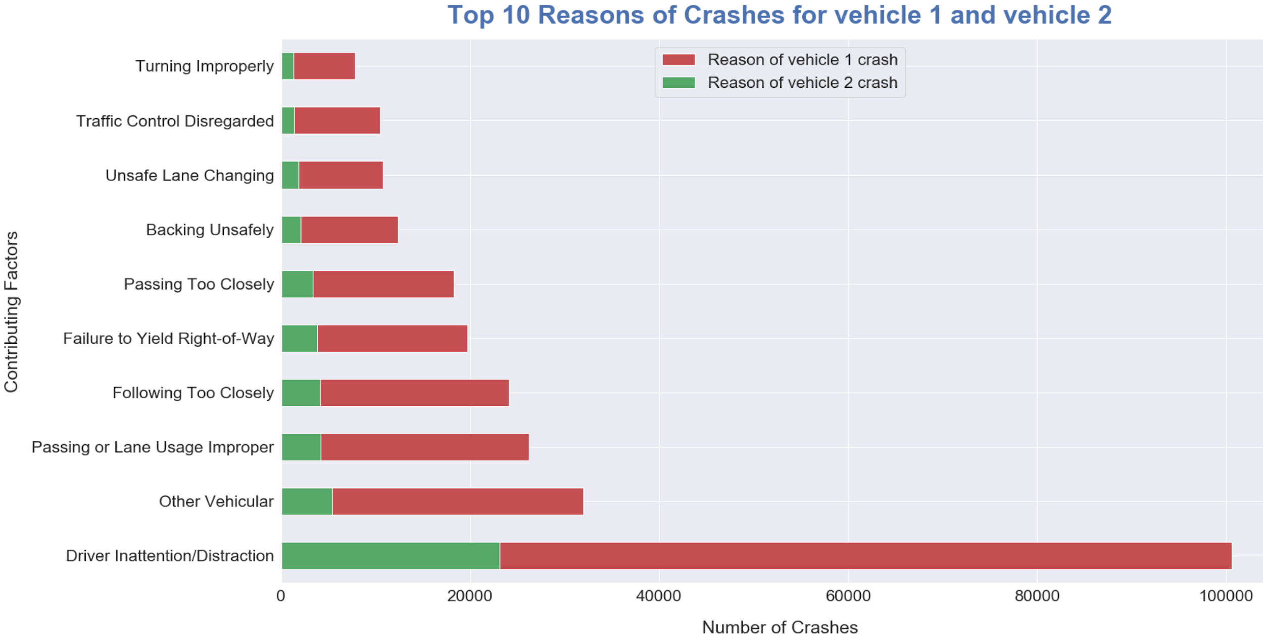
How? Top 10 contributing factors make up 84% of all accidents from known factors
[32.25, 10.25, 8.41, 7.73, 6.32, 5.86, 3.96, 3.45, 3.35, 2.5]% corresponding to picture below

Slide 6
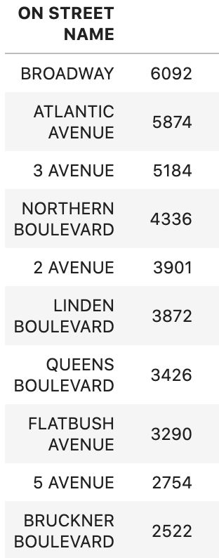
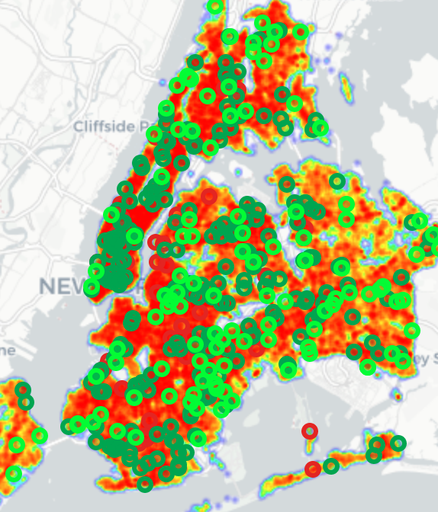
Where? Heat map: Where, how, when info at once

Slide 7
Conclusions
Implement stricter rules (distracted driving: 32%, avoidable)
Two way street has more accident than one way street (forest hills)
Explore areas for traffic light and traffic signs (Broadway Junction)
Hi-way-(eg. LIE, BQE), airlift disabled vehicle !

Slide 8
Next Steps!
Besides available data, field survey of road conditions
Is airlifting disabled vehicle from highways possible?
May be flying cars !!!

Slide 9

Thank You!
Galvanize DSI team
Contact info:
●Name : Tikam
●Linkedin : tcomr
●Github : tcomr

Slide 10

Questions?

Slide 11
References:
https://data.cityofnewyork.us/Public-Safety/Motor-Vehicle-Collisions-Crashes/h9gi-nx95
Galvanize DSI Instructors

